Slide 1

OOSE Project
Air Ticket Reservation System
Submitted By :
Ishaan Jain (2K18/SE/067)
Dheeraj Rukwal (2K18/SE/055)
Submitted To :
Dr. Ruchika Malhotra

Slide 2
Introduction
The most common mode of travelling these days is by airlines. Air ticket reservation systems are most widely used these days. The Air Ticket Reservation System is used widely these days. The airlines are trying to attract more passengers towards their system by providing them with many functionalities such as providing them discounts giving them access to book tickets online using the internet and much more.We are intending to develop an automated system for air ticket reservation.
Problems in the Existing System
Inability of passengers to select seat(s) for their chosen flight(s) from the existing reservation system
The system does not give any notification to the user about the delay in the flights.
Most of the work is done manually.
Luggage gets misplaced .
The existing system does not provide any information about the the aircraft or pilot and his history .
The proposed system has the following functionalities
The passengers have the option to choose their seat in case it is not available they can choose their preferred seat from the available ones.
The payment registration cancellation of the flights is done online.
Add luggage information during flight booking .
The payment , registration and cancellation of the flights is done online.
All the information about the flight is provided
Administrator has the access to all of the system and can maintain the system information.

Slide 3
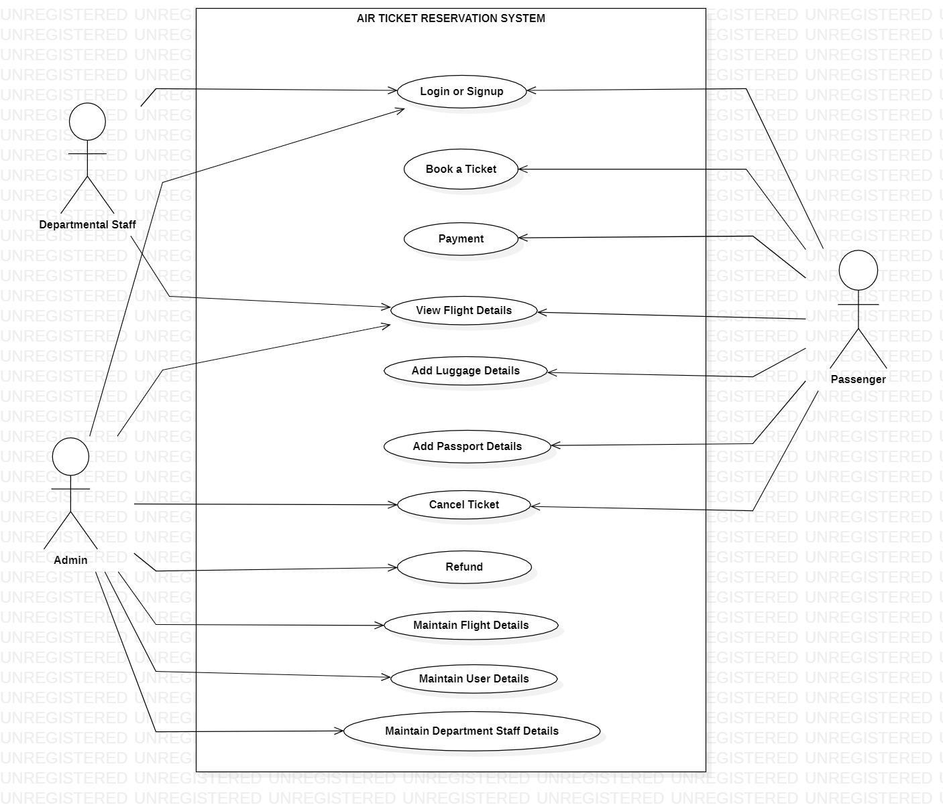
Use Case Diagram
Actors
Passenger
Administrator
Departmental Staff
Use Cases
Login or Signup
Booking a Ticket
Payment
View flight Details
Maintain Flight Details
Cancel Ticket
Refund
Add luggage Details
Add Passport Details
Maintain User Details
Maintain Staff Details

Slide 4
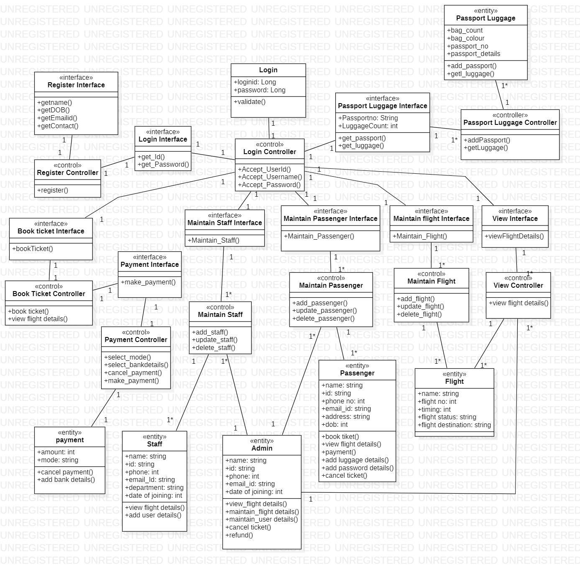
Class Diagram
Entity Classes :
Staff Entity
Passenger Entity
Admin Entity
Flight Entity
Payment Entity
Passport, Luggage Entity
Interface Classes :
Login Interface
Register Interface
Book Ticket Interface
Payment Interface
Maintain Staff Interface
Maintain Passenger Interface
Maintain Flight Interface
View Interface
Passport Luggage Interface
Control Classes :
Login
Register
Book Ticket
Payment
Maintain Staff
Maintain Passenger
Maintain Flight
View
Passport Luggage

Slide 5
Software Requirement Specification
Purpose :
The Air Ticket Reservation System is a web based automated system and can be used anywhere anytime.The main purpose of the system is to maintain information about flights, passengers ,staff members and provide passengers with the functionality of booking tickets online. The information is stored in order to have access to all actors in the system . The system is used to authenticate passengers by their id’s. It is designed to provide users more functionalities and provide an easy interface to the users.
Scope :
The payment registration cancellation of the flights is done online
The passengers have the option to choose their seat in case it is not available. They can choose their preferred seat from the available ones.
Add luggage and passport information during flight booking.
All the information about the flight is provided.
The system provides the users notification about the delay and cancellation in flights.
The system is able to maintain the details of the passengers, staff and flights.
Overall Description : This ARTS is a automated system which is able to maintain the information regarding the actors and book tickets online and provide other functionalities as well. The front -end is developed using HTML,CSS , Bootstrap and back end by Javascript , node js and express.

Slide 6
Interfaces and Constraints
User Interfaces : Login , Maintain Flight Details, Maintain Passenger Details, Maintain Flight Details,Search Flight etc
Software Interfaces : Javascript, Node JS, Express JS for back end.HTML CSS for front end.MY SQL for database .
Hardware Interfaces : The screen resolution should be of more than 1000 pixels.
Product Functions :
Administrator -- Maintain Flight , Maintain Passenger, Maintain Staff, Cancel Ticket, Refund.
Passenger -- Book Ticket , Payment, Cancel Ticket, Add Passport Details, Add Luggage Details.
Constraints :
There is only one admin in the system . The passengers are provided a unique ticket number that they have to remember for cancellation if they want too.The cancel ticket is done by the admin and the passenger only. There is no provision to any guest Login.Only the admin is able to maintain the details.
Assumptions and Dependencies :
The login ID and the password must be created by the admin and communicated to the user confidentially to provide unauthorized access to the system.
At this stage no speed and memory constraints are imposed on the system although the functions would be optimized in terms of speed and memory.
Proper Working is dependent on the internet connectivity of the user.

Slide 7
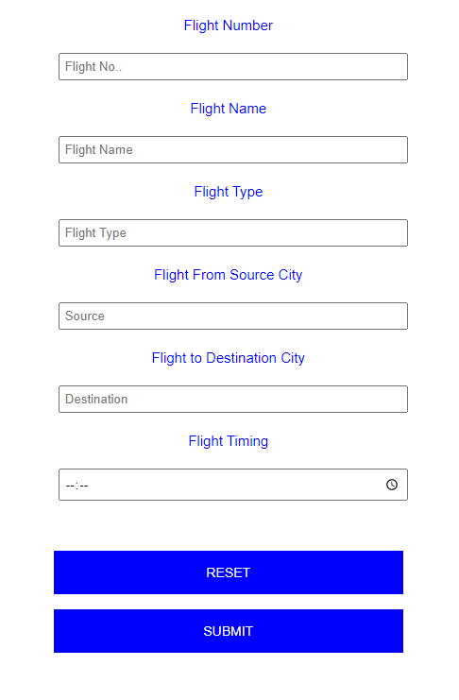
Use Case Description
Validity Checks :
All the fields are required fields . No input field should be kept empty
The length of flight name should be between 6 and 20.
The flight number length should be exactly six
Source city and the destination city name cannot be same.
Source and destination city names should contain alphabets only

Slide 8
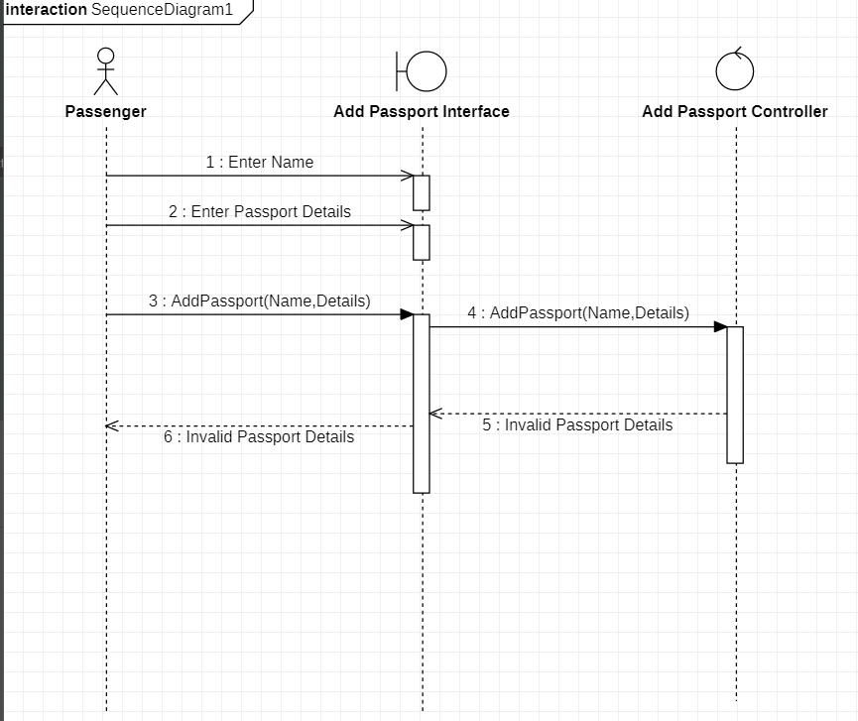
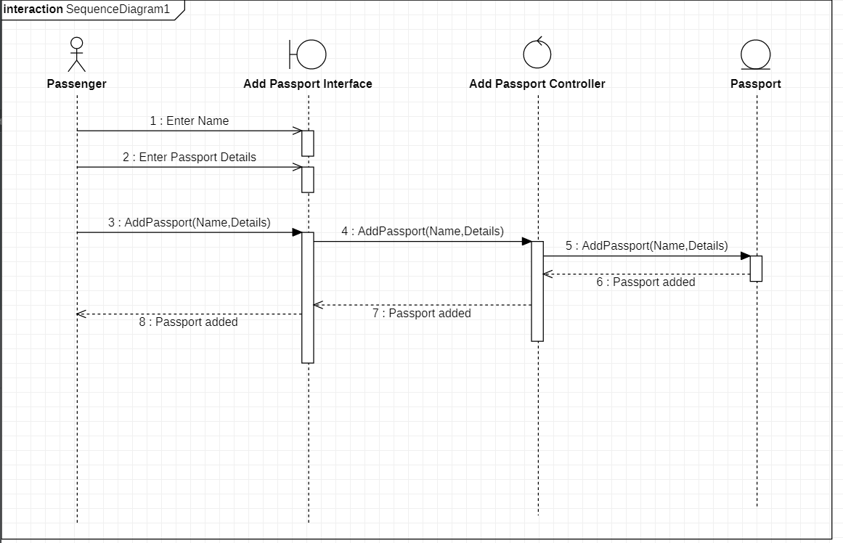
Sequence Diagram
Add Passport : Alternate Flow - Invalid Details
Add Passport : Basic Flow

Slide 9
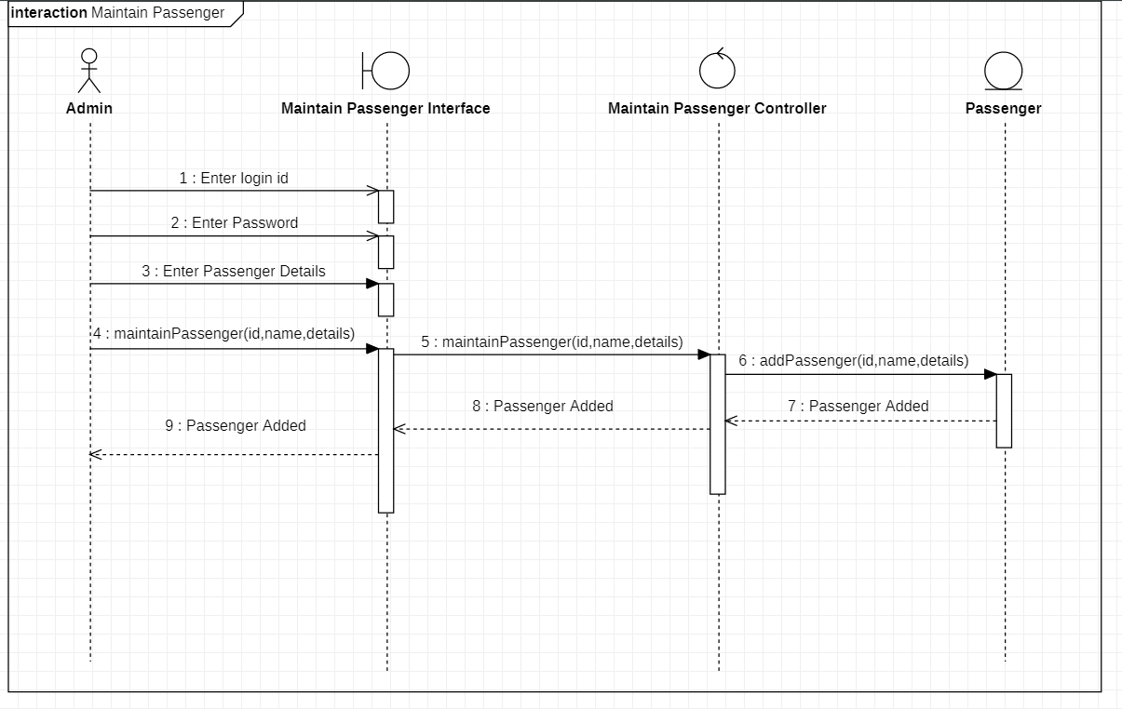
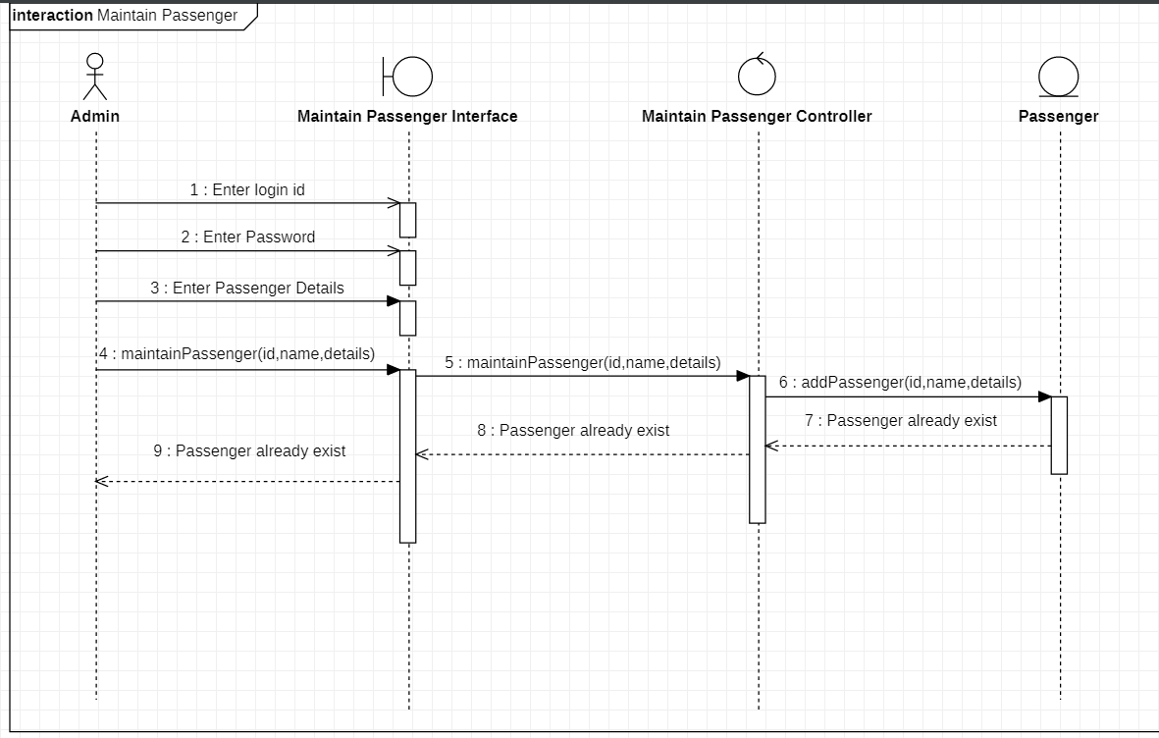
Add Passenger
Basic Flow
Add Passenger
Alternate Flow :
User Already Exist

Slide 10
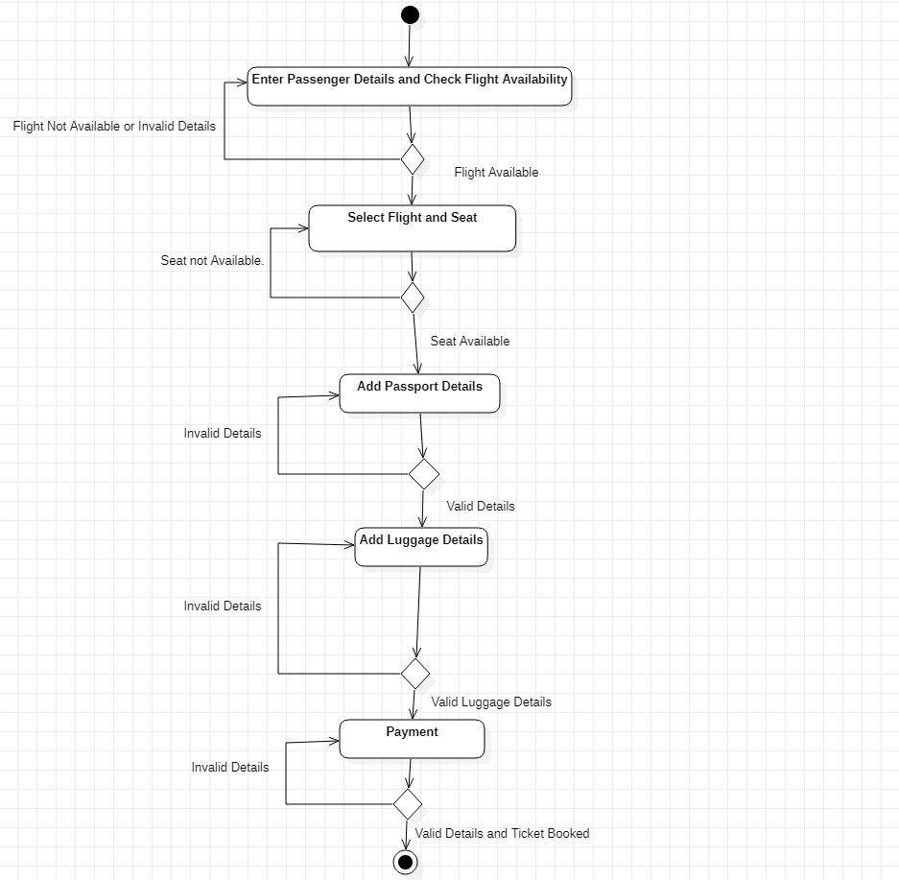
Activity Diagram
Book Ticket

Slide 11
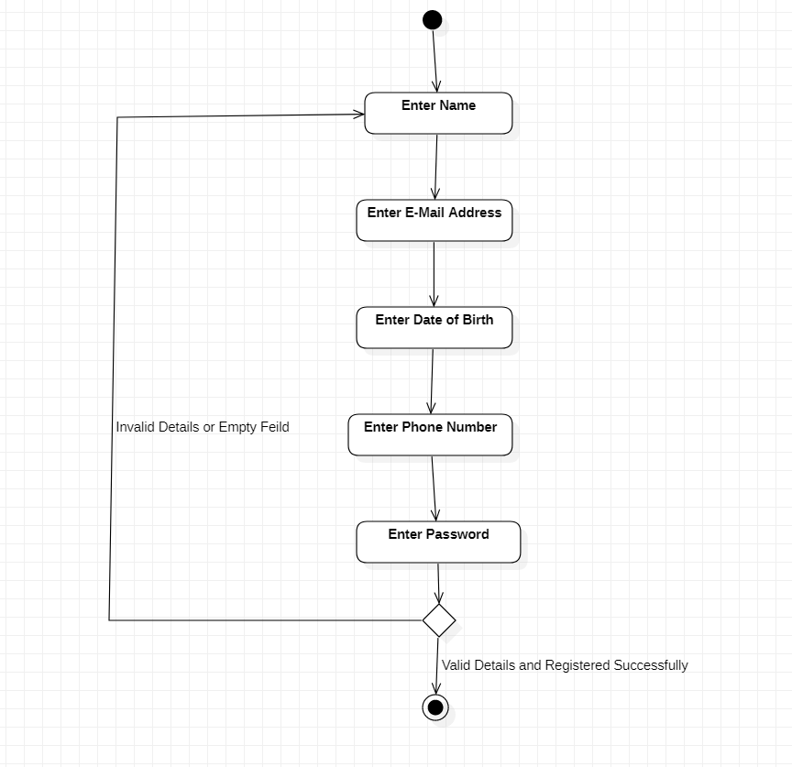
Register

Slide 12
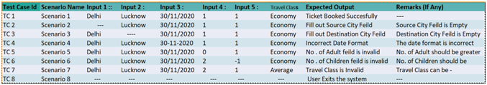
Test Case Matrix : Book Ticket

Slide 13
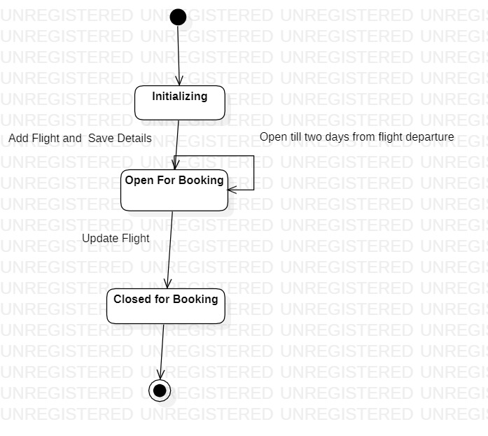
State Chart Diagram
Booking of Flight

Slide 14
Thank you.

